Slide 1
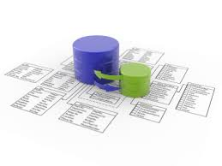




Databases
Database Course Program, Evaluation, Exams
SoftUni Team
Technical Trainers
Software University
http://softuni.bg

Slide 2


Table of Contents
Course Objectives
Course Program
Trainers Team
Examination
Learning Resources

Slide 3





Level #3 at the Software University
Databases
10 times + exam + TW
4 weeks * 3 times
DB Apps
8 times + exam + TW
3 weeks * 3 times
WS & Cloud
8 times + exam + TW
3 weeks * 3 times
Web Dev.
4 times + exam
2 weeks * 2 times
MVC
7 times + exam + TW
3 weeks * 3 times
QA Engineering
Marketing and SEO
Data Structures and Algorithms

Slide 4

Databases
Course Objectives & Program

Slide 5

Databases – Course Program
Course Introduction
Introduction to Databases
Introduction to MSSQL and MySQL
Data Modeling and E/R Diagrams
SQL Basics
Advanced SQL
T-SQL and Stored Procedures

Slide 6

Databases – Course Program (2)
SQL Performance
Transactions
NoSQL Databases
MongoDb & Redis
Lab
Exam Preparation
Practical Exam

Slide 7

The Trainers Team

Slide 8
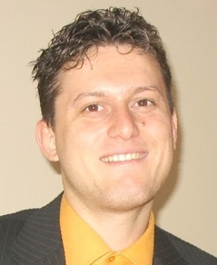
Trainers Team
Svetlin Nakov, PhD
Training & Inspiration Manager @ Software University
20+ years software development experience
10+ years experience as trainer
Author of 7 programming books
Speaker at hundreds of events
Web site & blog: www.nakov.com

Slide 9

Trainers Team (2)
Vladimir Georgiev
Software Engineer and Technical Trainer @ Software University
Top performing graduate from the Telerik Software Academy (2013)
Student in Technical University
Computer and Software Engineering
Web site & blog: www.VGeorgiev.org

Slide 10

Trainers Team (3)
Boris Hristov
SQL Server Consultant, Trainer and MVP
Technical Author for Pluralsight
International Speaker
SQL Server Trainer @ New Bulgarian University
Hosts "SQL Hangout" video conversations
Web site & blog: www.borishristov.com

Slide 11

Databases: More Details
Duration, Languages, Technologies

Slide 12


Training Duration – Databases
Lectures: ~ 20 hours (onsite + YouTube videos)
Practical exercises (in class): ~ 20 hours
Homework: ~ 30-40 hours
Teamwork project: ~ 10-20 hours
Schedule: Feb 2015
Practical exam: 1 March 2015

Slide 13



Why English?
Why the slides are in English?
English is the native language of the software engineers
Specific terminology should be in English
Translations are inaccurate and funny
Just learn English!
No excuses

Slide 14
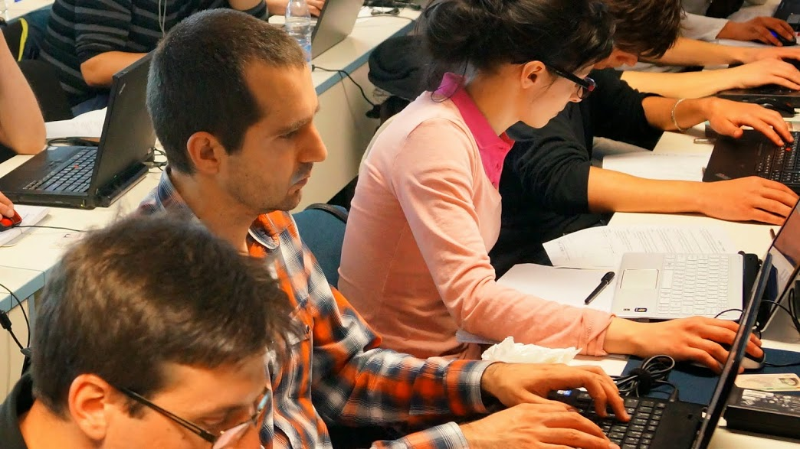


Databases
Evaluation Criteria

Slide 15

Scoring System for the "Databases"
Practical exam – 90%
Homework + evaluation – 5% + 5%
Presence in class: 5% (onsite students only)
Bonuses: up to 10%

Slide 16

Databases – Practical Exam
The practical exam tests your SQL skills
Evaluated through an automated judge system
You will be given a database (SQL script)
You should write several SQL queries
The returned data will be evaluated in the judge system
Correct result → gives the score for the problem
Incorrect result → 0 score

Slide 17

Homework Assignments
Doing your homework is very important!
Programming can only be learned through a lot of practice!
You should write code every day!
Each lecture is followed by a few exercises
Try to solve them in class
The rest are your homework
Homework assignments are due in 1-2 weeks after each lecture
Submission will be accepted through our web site: softuni.bg

Slide 18

Homework Peer Reviews
Give feedback to a few random homework submissions
Students submit homework anonymously
Please exclude your name from the submissions!
For each homework submitted
Students evaluate 3 random homeworks
From the same topic, after the deadline
Give written feedback, at least 200 characters
Low-quality feedback → report for punishment
Everyone will get feedback for their homework

Slide 19










Resources
What We Need Additionally?

Slide 20

Course Web Site & Forums
The Databases official web site:
Register for the "Software University Forum":
Discuss the course exercises with your colleagues
Find solutions for all course exercises
Share source code / discuss ideas / help each other
https://softuni.bg/trainings/20/Databases-Feb-2015
https://softuni.bg/forum

Slide 21



Databases Slides and Videos
All lecture slides, videos, homework assignments, projects and other resources are open content, available for free
Visit the course web site to access the course resources

Slide 22

Databases – Additional Resources
Online SQL tutorial at W3 Schools
http://www.w3schools.com/sql/
SQL Zoo – interactive SQL tutorial
http://sqlzoo.net
SQL and Database Tutorial
http://www.tutorialspoint.com/sql/

Slide 23
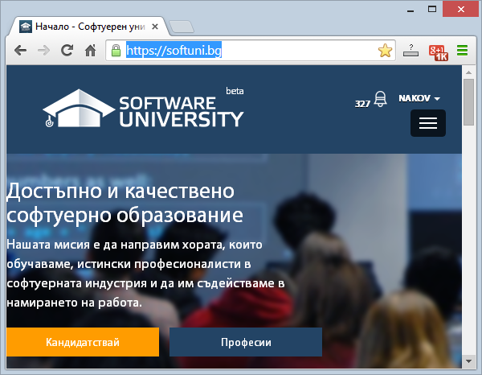
Software University Learning System (SULS)
Software University Learning System (SULS)
www.softuni.bg
Important resource for students
Homework submissions
Homework check-up
Exams and results
Reports about your progress
…

Slide 24
Recommended Software
Microsoft SQL Server 2014 (Express or Standard Edition) + SQL Server Management Studio 2014
SQL Server 2012 may work as well
MySQL 5.6 + MySQL Workbench 6
Oracle 11g XE (Express Edition) + Oracle SQL Developer 4.0
MongoDB 2.6 + Robomongo
SQLite + System.Data.SQLite.EF6
Visual Studio Community 2013

Slide 25







Databases
https://softuni.bg/courses/databases

Slide 26
License
This course (slides, examples, demos, videos, homework, etc.) is licensed under the "Creative Commons Attribution-NonCommercial-ShareAlike 4.0 International" license
Attribution: this work may contain portions from
"Databases" course by Telerik Academy under CC-BY-NC-SA license

Slide 27





Free Trainings @ Software University
Software University Foundation – softuni.org
Software University – High-Quality Education, Profession and Job for Software Developers
softuni.bg
Software University @ Facebook
facebook.com/SoftwareUniversity
Software University @ YouTube
youtube.com/SoftwareUniversity
Software University Forums – forum.softuni.bg

